Slide 1



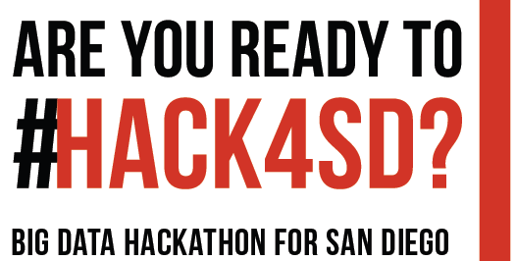

2019
Please Tweet about this event with #HACK4SD

Slide 2


Welcome Back (Week 2)
Co-organizers
Dr. Amy Schmitz Weiss (Journalism and Media Studies)
Dr. Ming Tsou (HDMA Center, Geography)
Dr. Atsushi Nara (HDMA Center, Geography)

Slide 3
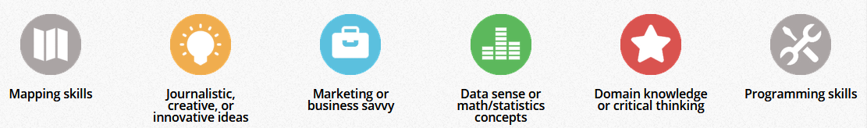

Hackathon is a team work effort!
The 2019 Big Data Hackathon for San Diego will promote Data Science and Big Data Analytics for both students and educators and demonstrate technological applications for SMART LIVING

Slide 4
YOUR INNOVATION CAN WIN PRIZES
Best Overall Projects:
1st Prize: $600
2nd Prize: $300
3rd Prize: $150
Most innovative idea: $100
Strongest teamwork: $100
Additional $2500 In Prizes!!!

Slide 5
Additional Prizes for SDSU Students
Sponsored by Zip Launch Pad (team must have at least one active SDSU student. Winning team must apply to the ZIP Launchpad through our application cycle and be admitted by the Selection Committee to receive 2nd $500 award).
Best Overall $500
Women in STEM - Best Startup Idea $500
VETERAN- Best Startup Idea $500
Best Startup Idea - Aging Independently $500
Additional Prizes for K-14 Students
Sponsored by Encoding Geography (NSF project).
Young Geo-computational Thinker $500 (All members of the team must be second-year college students or younger. The team must apply geographical and computational thinking (geo-computational) skills to their solution)

Slide 6
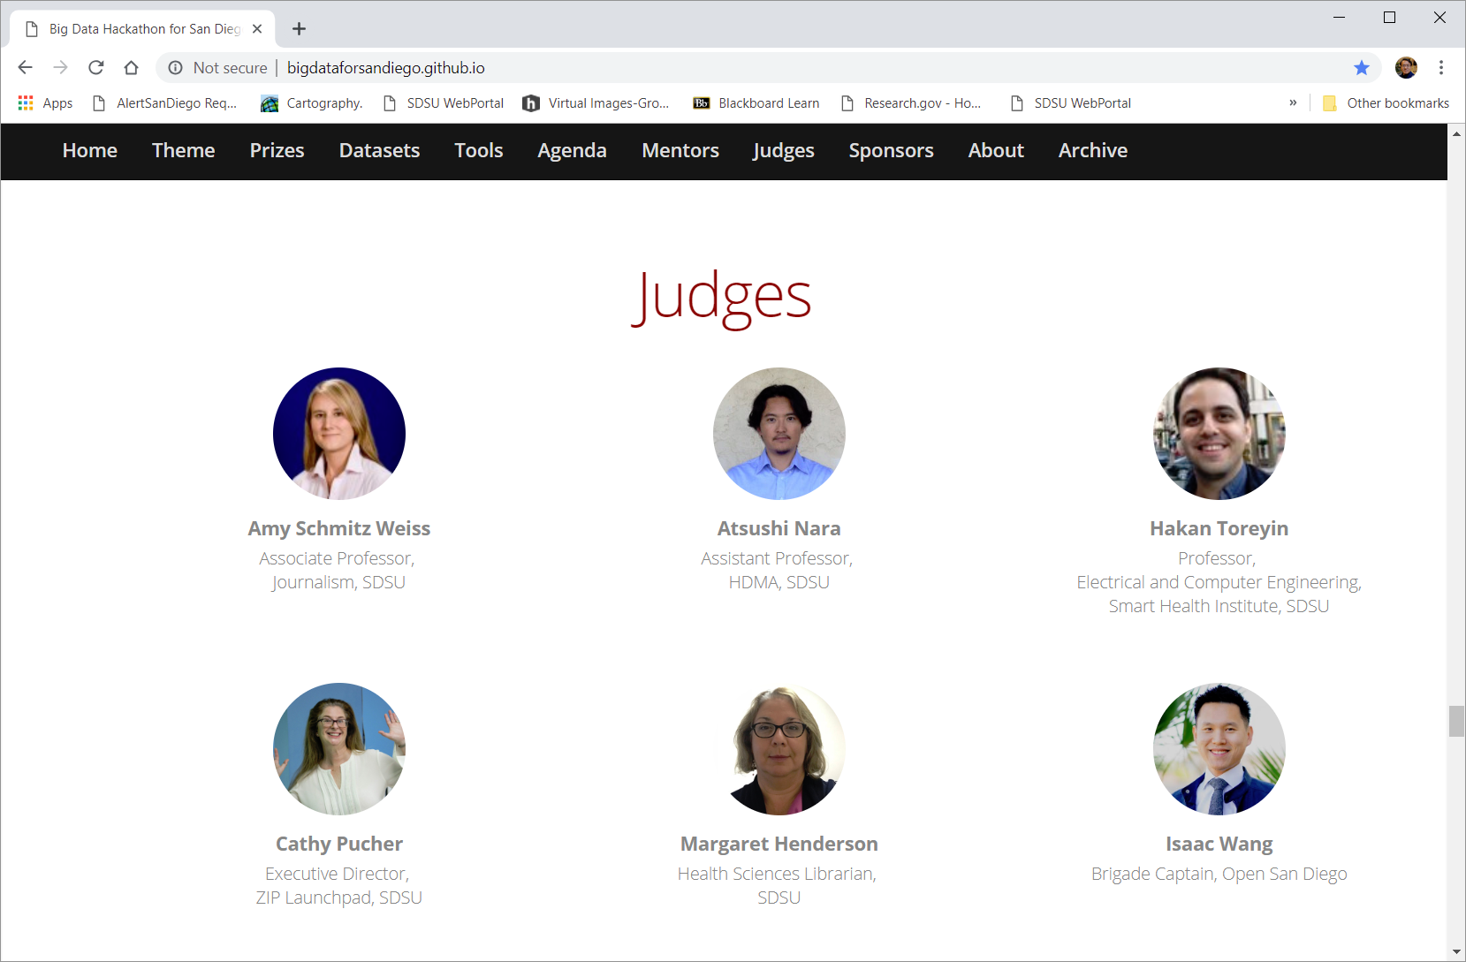
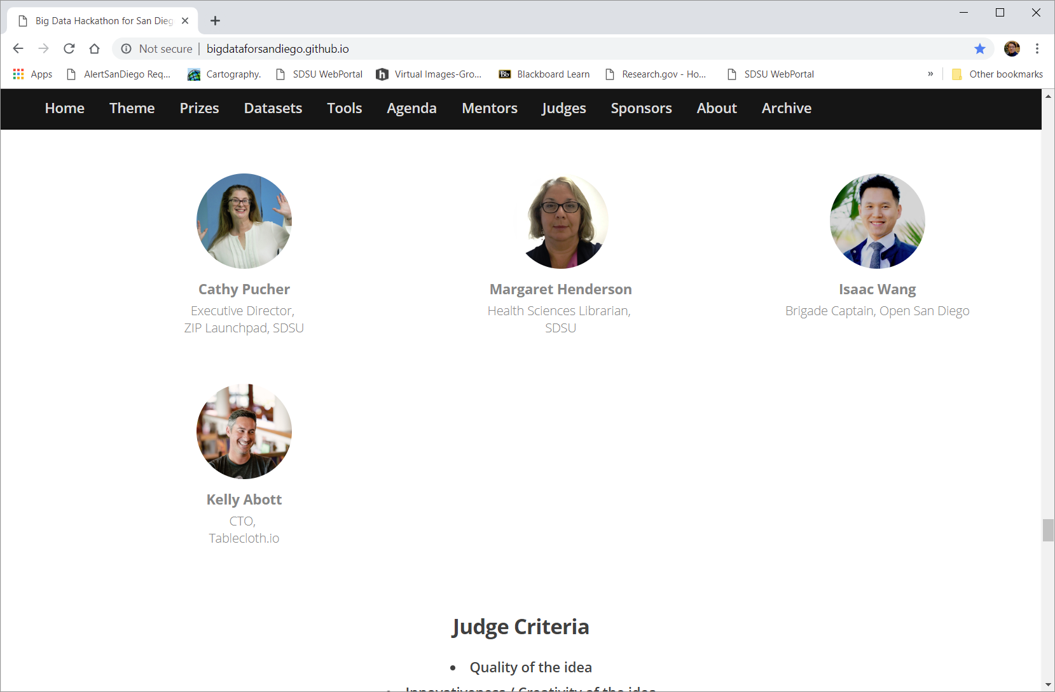
Thank to our Judge Panel

Slide 7
Judge Criteria
Quality of the idea
Innovativeness / Creativity of the idea
Readiness of the idea to go to market
Impact of idea on Smart Living
The demonstration of teamwork / collaboration
The development and design of the idea (can include code but not required)

Slide 8
Agenda
Day 2- March 16, 2019 (Saturday) (Final Presentation Day)
9 a.m.-9:30 a.m. Overview & Q&A Session and introduction to the Hackathon Judge Criteria and the new Big Data Analytics Degree at SDSU (Ming and Amy).
9:30 a.m. – 10:00 a.m. Practice Pitch Time. Check with Dr. Nara about the presentation slides and final project form on Github.
10:00 AM. All teams MUST submit their final project form and presentation slides to Github BEFORE 10:00 am. (each team presentation schedule will be announced at 10:10am).
10:15 AM – 12:00PM First Session for the Team Presentations (16 Teams), Each Team will have 4 mins Presentation time + 1 min Q&A (5 mins total).
12:00 pm. – 1:00 p.m. Lunch (Pizza)
1:00 p.m. - 2:15 p.m. Second Session for Team Presentations (all remaining 12 teams) (4 mins presentation + 1 mins for Q&A for each team).

Slide 9
Agenda
12:00 pm. – 1:00 p.m. Lunch (Pizza)
1:00 p.m. - 2:15 p.m. Second Session for Team Presentations (all remaining 12 teams) (4 mins presentation + 1 mins for Q&A for each team).
2:15pm – 2:30pm (Coffee Break).
2:30 p.m – 3:00pm Introduce the SCALE SD hackathon opportunity (Daniel Obodovski, 10 mins), and the Lavin Center (Alex DeNoble, 5 mins), Zip LaunchPAD intro (Doug 5 mins). Participant Survey and Evaluation form (10 mins).
2:15 p.m. – 3:45 p.m. Judge Deliberations (1.5 hours)
3:45 pm - 4:15 pm Awards (10) and Closing Ceremony (Note: the Award Ceremony may start earlier such as 3:30pm if the Judge Deliberations finish earlier). Team members must be present at the awards ceremony to receive prizes.
4:30 p.m. End of Day 2.

Slide 10
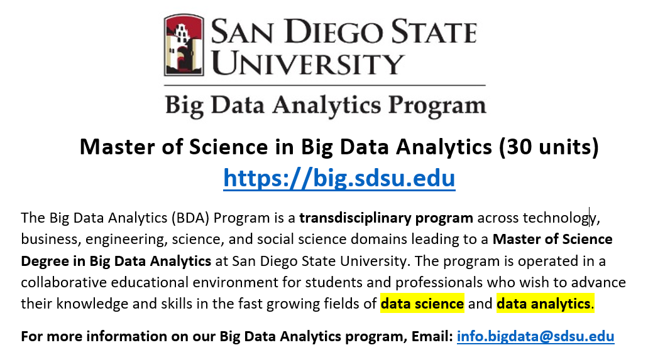
https://big.sdsu.edu

Slide 11

Total required units: 30 units (Two years).
Required FOUR core courses (12 units)
BDA 500 / GEOG 594 Big Data Science and Analytics Platforms (3)
BDA 572 / LING 572 Python Scripting for Social Science (3)
BDA 686 / MIS 686 Enterprise Data Management (3)
BDA 623 / BA 623 Statistical Analysis (3)
Electives (6-12 units) Prior approval of electives by the graduate advisor is required for their application towards the degree.
Capstone and culminating experience (3-6 units)
BDA 600 Big Data Analytics Capstone Seminar (3)
BDA 799A Thesis (3): Plan A only
BDA 799B Thesis or Project Extension (0): Plan A only
Comprehensive examination: Plan B only

Slide 12
Electives (6-12 units) Prior approval of electives by the graduate advisor is required for application toward the degree. Students should be aware that many electives require prerequisites that will not fulfill degree requirements.
ACCTG 621 Accounting Information Systems (3)
ACCTG 673 Accounting Information Systems (AIS) Development (3)
BA 625 Financial and Management Accounting (3)
CS 503 Scientific Database Techniques (3)
CS 514 Database Theory and Implementation (3)
CS 653 Data Mining and Knowledge Discovery (3)
ENGL 560 Literature in the Digital Age (3)
ENGL 562 Digital Methods in Literacy Studies (3)
GEOG 583 Internet Mapping and Distributed GIServices (3)
GEOG 584 Geographic Information Systems Applications (3)
GEOG 593 GIS for Business Location Decisions (3)
GEOG 780 Seminar in Techniques of Spatial Analysis (3)
LING 571 Computational Corpus Linguistics (3)
LING 581 Computational Linguistics (3)
LING 583 Statistical Methods in Text Analysis (3)
MATH 524 Linear Algebra (3)
MIS 620 Electronic Business and Big Data Infrastructures (3)
MIS 687 Data Communications and Distributed Data Processing (3)
MIS 691 Decision Support Systems (3)
MIS 748 Multi-Variate Analytics (3)
MIS 749 Business Analytics (3)
SOC 607 Advanced Quantitative Methods (3)
SOC 730 Seminar in Social Institutions (3)
STAT 510 Applied Regression Analysis (3)
STAT 550 Applied Probability (3)
STAT 551A Probability and Mathematical Statistics (3)

Slide 13
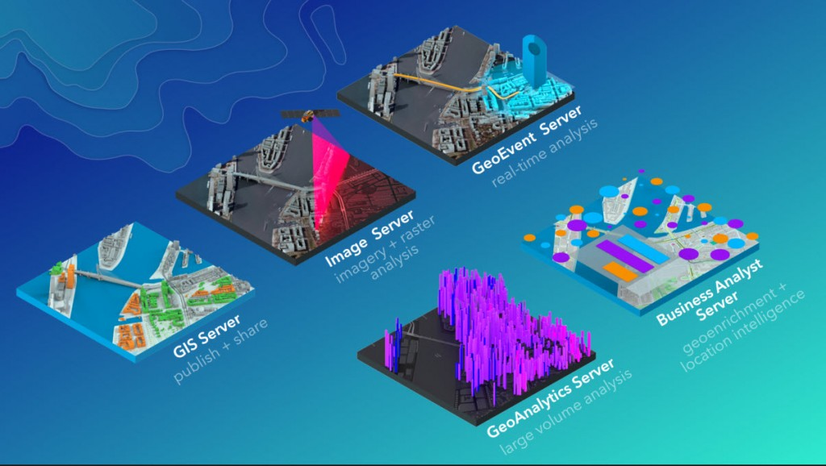
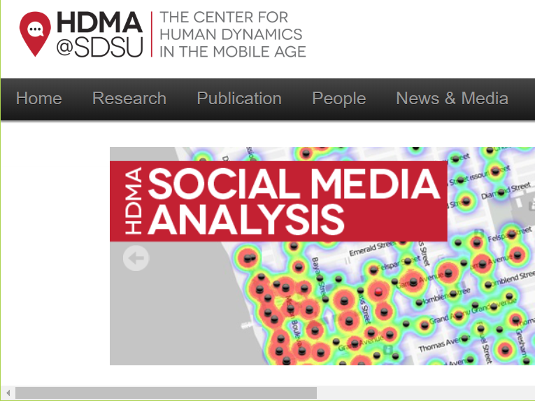
A Unique Opportunity to Integrate Research and Education
The New Big Data Analytics Program (Master of Science) at SDSU
Students can select thesis (Plan-A) or research study (internship) (Plan-B) with comprehensive exam. They will partner with SDSU faculty and research projects who need data analytic tasks or with the San Diego local start-up companies for thesis topics or research study. The new Big Data Science (BDS) Education Program at SDSU will focus on the training of practical skills required in data science, including data visualization, machine learning, mathematics, statistics, computer science, communication, and domain expertise.

Slide 14
